Slide 1





FINANCIAL INSIGHTS
CREDIT CARD EXPENDITURE FORECASTING
Enhancing Marketing to Boost Average Credit Card Spending
Presented by J VIGNESH

Slide 2



CREDIT CARD FORECASTING
OBJECTIVE
Enhance marketing efforts to increase average credit card spending among potential clients by leveraging data-driven insights for targeted strategic planning.
Key Goals:
• Identify high-potential customer segments for credit card usage
• Develop predictive models to forecast spending behavior
• Enable personalized marketing campaigns based on consumption patterns
• Drive measurable increases in average credit card expenditure
• Support business decisions with actionable analytics

Slide 3


CREDIT CARD FORECASTING
BUSINESS
PROBLEM
The bank faces a critical challenge: how to boost credit card spending among potential customers who are not yet maximizing their card usage.
Key challenges include:
• Identifying customers with untapped spending potential
• Tailoring services based on consumption behavior and demographics
• Gaining strategic advantage through predictive insights
• Designing targeted marketing campaigns that resonate with specific customer segments
Without data-driven insights, marketing efforts remain generic and less effective at driving card utilization.

Slide 4

CREDIT CARD FORECASTING
DATA OVERVIEW
Customer Demographics
Customer Behaviour
Comprehensive customer profile data including age, gender, employment status, income levels, and other demographic attributes essential for segmentation and targeting strategies.
Three months of detailed consumption expenditure data capturing spending patterns, transaction frequency, and behavioral trends across various spending categories.
Customer Consumption
Total Dataset Summary
Unique Customer ID linked with credit card spend data, enabling precise tracking and analysis of individual consumption patterns for accurate forecasting.
20,000 total customer records with 28 distinct features merged from three integrated data sources, providing a robust foundation for predictive modeling.

Slide 5



CREDIT CARD FORECASTING
DATA INTEGRATION & CLEANING
Our data preparation process ensured high-quality inputs for accurate forecasting:
• Merged three datasets on unique Customer ID using left join strategy
• Verified data integrity: no duplicate rows found across merged dataset
• Separated 5,000 records with missing target values for later prediction
• Imputed minor missing values in demographic and behavioral features
• Final cleaned dataset ready for feature engineering and modeling

Slide 6

CREDIT CARD FORECASTING
STATISTICAL PROFILING
Average credit card spend is approximately 9,369 with a maximum of 160,735, revealing a high right-skew distribution. The standard deviation of 41,341 indicates substantial variance across customer spending patterns. These characteristics necessitate data transformations to stabilize the dataset for accurate predictive modeling.

Slide 7

CREDIT CARD FORECASTING
KEY PERFORMANCE INDICATORS
Credit Utilization Ratio
Digital Engagement Score
Average utilization below 70% indicates untapped credit capacity. This presents a significant marketing opportunity to encourage increased card usage through targeted promotions and rewards programs.
Current engagement at 60% shows room for improvement. Digital promotional campaigns and mobile app features can drive higher interaction rates and subsequently boost spending behavior.
Credit to Debit Ratio
Mass Market Positioning
Ratio of 2.11 indicates profitable credit card preference over debit. Reward programs are effectively driving credit usage, presenting opportunity for enhanced loyalty initiatives.
Average spend of 388 with potential to increase to 450. Targeted campaigns for mass market segment can unlock significant revenue growth through personalized offers and incentives.

Slide 8


CREDIT CARD FORECASTING
KEY PERFORMANCE
INDICATORS
Inflow to Outflow Ratio: 1.13
This indicates stable liquidity among customers, suggesting a healthy balance between income and expenses. This stability presents an opportunity for credit limit increases for qualified customers.
Loan Burden Index: ~3%
This metric indicates potential risk exposure in the customer base. While relatively low, it requires careful monitoring and explicit customer consent before offering additional loan products to maintain responsible lending practices.

Slide 9

CREDIT CARD FORECASTING
FEATURE TRANSFORMATION
Winsorization
Logarithmic Scaling
Capped top 1% of spenders at 40,000 to reduce the impact of extreme outliers and noise in the dataset. This technique preserves data integrity while minimizing distortion from high-value anomalies.
Applied log transformation to the target variable to normalize the heavily right-skewed spend distribution. This stabilizes variance and improves model performance on regression tasks.
Categorical Encoding
Before/After Comparison
Converted categorical variables including income brackets, gender, and account type into numeric format using label encoding. This enables machine learning algorithms to process non-numeric features effectively.
After transformation, spend distribution shifted from highly skewed (max 160,735) to normalized range. Histogram comparison shows successful reduction in variance and improved data symmetry.

Slide 10

CREDIT CARD EXPENDITURE FORECASTING
Gradient Boosting Model
MODEL EVALUATION OVERVIEW
RMSE
37.43%
Tested 6 regression algorithms to predict credit card spending: Linear Regression, Random Forest, AdaBoost, Gradient Boosting, Decision Tree, and XGBoost. Metrics evaluated include RMSE and RMSE Percentage on inverse log-transformed target values. Initial best performer: Gradient Boosting with RMSE% of 37.43%, followed closely by Random Forest.

Slide 11


CREDIT CARD FORECASTING
HYPERPARAMETER TUNING RESULTS
GridSearchCV with 5-Fold Cross-Validation
Systematically searched optimal combinations across learning_rate, n_estimators, max_depth, and subsample parameters.
Optimal Parameters Identified
• Learning Rate: 0.01 (slower, more precise learning)
• N_Estimators: 500 (increased ensemble size)
• Max Depth & Subsample: Fine-tuned for generalization
Performance Improvement
Final RMSE% improved to 37.13%, demonstrating enhanced model stability and prediction accuracy over baseline Gradient Boosting configuration.

Slide 12
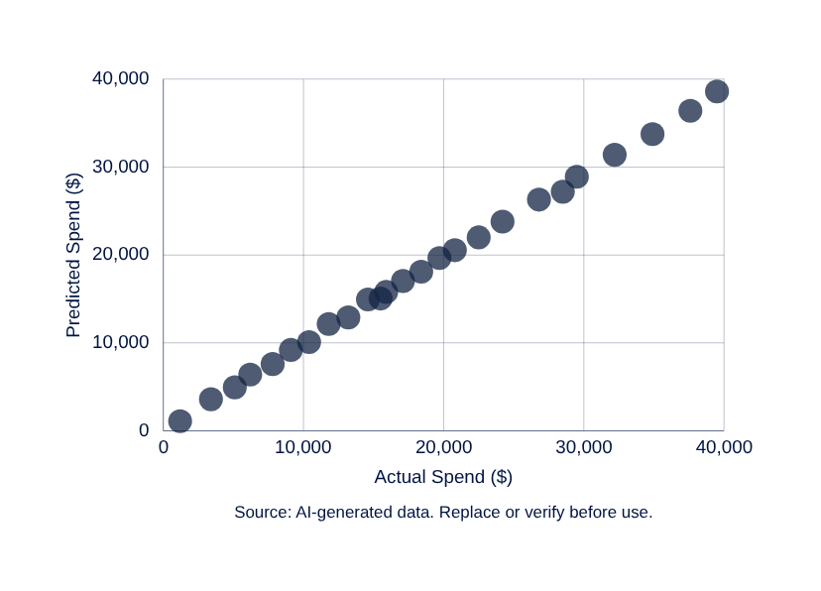



CREDIT CARD EXPENDITURE FORECASTING
ACTUAL VS PREDICTED SPEND
Our model demonstrates strong predictive accuracy for credit card expenditure. The scatter plot analysis reveals excellent performance in the 5,000-20,000 spend range where most customers fall. A conservative bias appears near the 40,000 cap for high spenders due to winsorization. The 45-degree reference line validates prediction quality across the core customer segment.

Slide 13
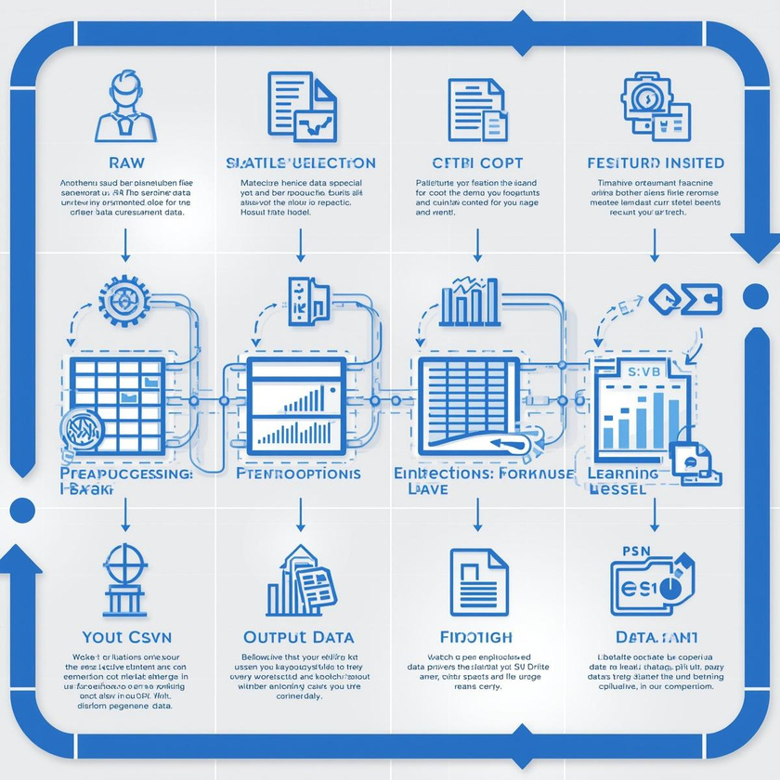

CREDIT CARD EXPENDITURE FORECASTING
PREDICTION ON MISSING DATA
With our validated Gradient Boosting model ready for deployment, we applied it to the 5,000 customers who had missing credit card spend values. The preprocessing pipeline remained identical to training, ensuring consistency in data transformation.
We utilized the top 10 most predictive features identified during model development to generate forecasted credit card consumption values. The resulting predictions were exported to Credit_Consumption_Predictions.csv for integration with business systems and marketing campaign planning.

Slide 14



CREDIT CARD FORECASTING
FINAL VALIDATION
The histogram overlay comparing predicted versus actual credit card spend confirms that our model accurately mirrors real-world spending patterns. This validation demonstrates the model's reliability for marketing strategy development and targeted campaign planning. The close alignment between distributions validates the Gradient Boosting model's suitability for forecasting customer expenditure and supports confident deployment for business decision-making.

Slide 15
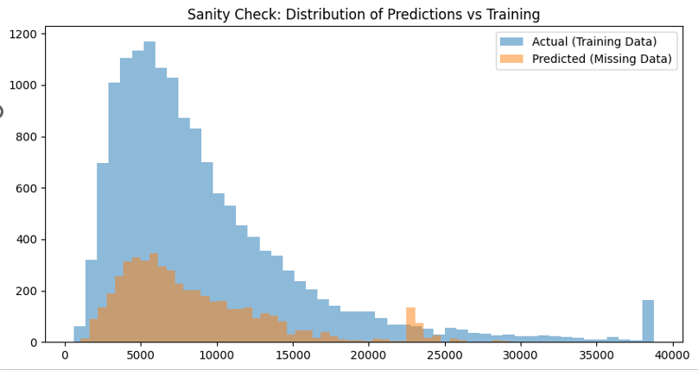

Slide 16


QUESTIONS & DISCUSSION
THANK YOU

